Slide 1

INSTITUTE : UIE
DEPARTMENT : CSE
Bachelor of Engineering (Computer Science & Engineering)
PROJECT BASED LEARNING IN JAVA
(20CST-319/20ITT-319)
TOPIC OF PRESENTATION:
Keywords, Tokens, Data types.
DISCOVER . LEARN . EMPOWER

Slide 2

Lecture Objectives
In this lecture, we will discuss:
Keywords, Tokens, Data types.

Slide 3
Java Identifiers:
All Java components require names. Names used for classes, variables and methods are called identifiers.
In Java there are several points to remember about identifiers. They are as follows:
All identifiers should begin with a letter (A to Z or a to z), currency character ($) or an underscore (_).
After the first character identifiers can have any combination of characters.
A key word cannot be used as an identifier.
Most importantly identifiers are case sensitive.
Examples of legal identifiers: age, $salary, _value, __1_value
Examples of illegal identifiers: 123abc, -salary

Slide 4
Keywords
abstract | continue | for | new | switch
assert | default | goto | package | synchronized
boolean | do | if | private | this
break | double | implements | protected | throw
byte | else | import | public | throws
case | enum | instanceof | return | transient
catch | extends | int | short | try
char | final | interface | static | void
class | finally | long | strictfp | volatile
const | float | native | super | while

Slide 5
Tokens
Compiler can identify some elements in program that are Tokens
A token is the smallest element of a program that is a specified meaning to the compiler.
In java, tokens include keywords, variables, constants, special characters, operations etc.

Slide 6
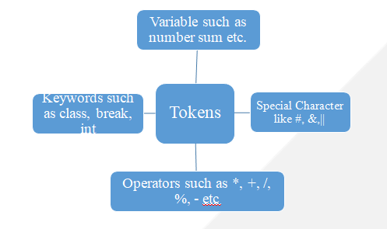
Tokens

Slide 7
Data types
Data Type | Size (inbits) | MinimumRange | MaximumRange | DefaultValue (forfields)
byte | 8 | -128 | +127 | 0
short | 16 | -32768 | +32767 | 0
int | 32 | -2147483648 | +2147483647 | 0
long | 64 | -9223372036854775808 | +9223372036854775807 | 0L
float | 32 | 1.40E-45 | 3.40282346638528860e+38 | 0.0f
double | 64 | 4.94065645841246544e-324d | 1.79769313486231570e+308d | 0.0d
char | 16 |  | 0 to 65,535 | '\u0000'
boolean | 1 | NA | NA | false

Slide 8
Difference:
The main difference between primitive and non-primitive data types are:
Primitive types are predefined (already defined) in Java. Non-primitive types are created by the programmer and are not defined by Java (except for String).
Non-primitive types can be used to call methods to perform certain operations, while primitive types cannot.
A primitive type has always a value, while non-primitive types can be null.
A primitive type starts with a lowercase letter, while non-primitive types start with an uppercase letter.
The size of a primitive type depends on the data type, while non-primitive types have all the same size.
Examples of non-primitive types are Strings, Arrays, Classes, Interface, etc.

Slide 9
QUIZ:
1. Java is a ........... language.
A. weakly typed
B. strongly typed
C. moderate typed
D. None of these
2. In Java byte, short, int and long all of these are
A. signed
B. unsigned
C. Both of the above
D. None of these

Slide 10
Summary:
In this session, you were able to :
• Learn about Keywords, Tokens, Data types.

Slide 11
References:
Books:
1. Balaguruswamy, Java.
2. A Primer, E.Balaguruswamy, Programming with Java, Tata McGraw Hill Companies
3. John P. Flynt Thomson, Java Programming.
Video Lectures :
https://www.youtube.com/watch?v=f8lCiYquj28
https://www.youtube.com/watch?v=e5ftceLyKbM
https://www.youtube.com/watch?v=TL7tdNp0raE
Reference Links:
https://www.w3schools.com/java/java_ref_keywords.asp
https://www.geeksforgeeks.org/list-of-all-java-keywords/
https://docs.oracle.com/javase/tutorial/java/nutsandbolts/_keywords.html
https://www.w3schools.com/java/java_data_types.asp
https://www.geeksforgeeks.org/data-types-in-java/
https://www.youtube.com/watch?v=bqPIWlnjWbA
https://www.youtube.com/watch?v=iFzA43xR04s

Slide 12
THANK YOU

